Slide 1
EVENT VENDORS
Business Leadership Symposium 2019

Slide 2
Speakers
Brian Farber, Office of the Associate Vice Chancellor for Student Affairs
Aaron Finder, Urbana Purchasing Office
Darren Strater, University Payables

Slide 3
Agenda
Food Truck Policy
Catering and Events
Coca-Cola Sponsorship Agreement
Contracted Vendors
Vendor Payments

Slide 4
Food Truck Policy
Brian Farber
Office of the Associate Vice Chancellor for Student Affairs

Slide 5
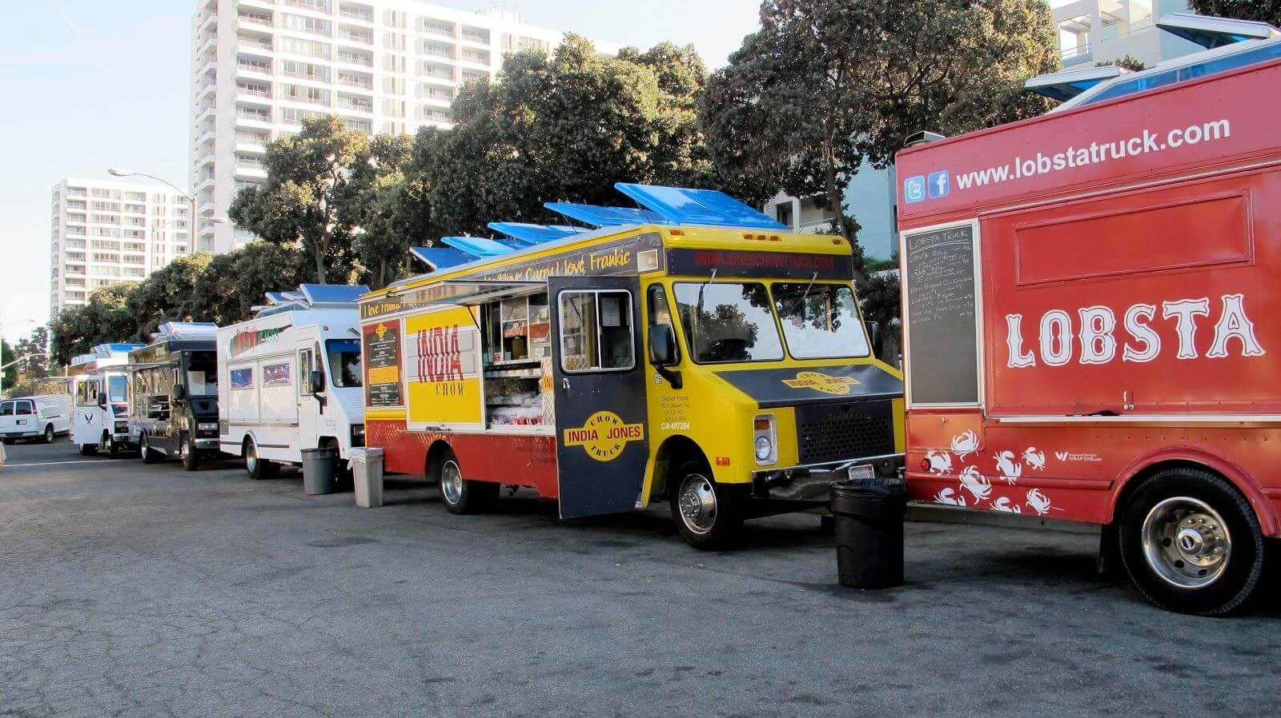
“Food Truck Policy”
As of today, Food Trucks are not permitted on University property!*
*Unless an exception is approved by the Office of the Chancellor
Food Trucks have been contracted by DIA to serve on game days
Food Trucks are “on campus” parked on city streets at city meters
Policy and process is in development

Slide 6
“Food Truck Policy”
Coming soon: Mobile Food Vendor (MFV) policy
  Campus Administrative Manual
  Administered by Illini Union Campus Vending (IU) and the Parking Department
  Involves a contract between MFV and IU
    Ensure safety and health inspections
    Prevent unfair competition with campus vendors
  Designated campus meter spaces
  University sponsors may request to host MFV at other location
    May require an additional contract with Purchasing

Slide 7
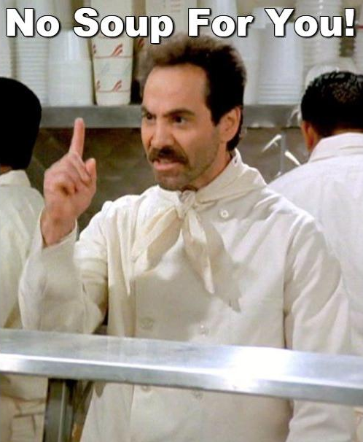
“Food Truck Policy” (continued)
But, as of today,
No Food Trucks
without permission of the Chancellor

Slide 8
Catering & Events
Aaron Finder
Urbana Purchasing Office

Slide 9
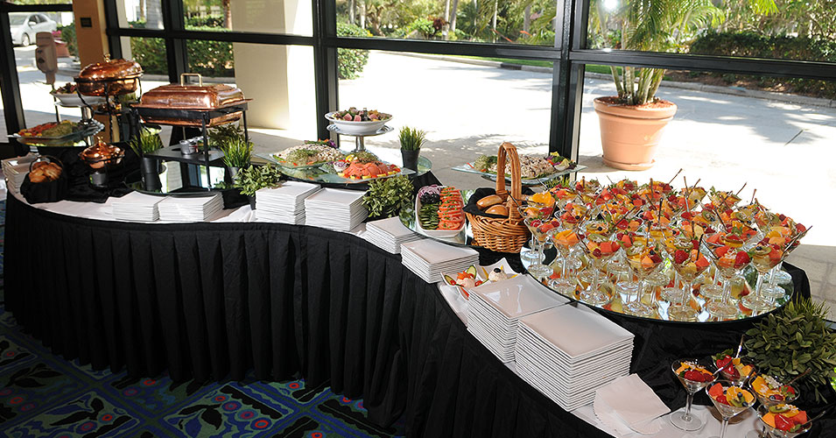
Catering & Events

Slide 10
What is a Catered Event and Non-Catered Event?
A catered event consists of food and beverage where the vendor also typically provides setup, food service, onsite preparation, and clean up.
A non-catered event consists of food/beverage delivery or drop off only. The delivery person does not provide onsite service.

Slide 11

What are my options?
University Caterer
Non-University Caterer

Slide 12
What is a University caterer?
University Catering is operated by the University and is the preferred caterer for Urbana Campus events. They offer food, beverages, floral arrangements, equipment, and much more.
Benefits of using University Catering include:
An approved purchase order is not required.
They provide service to locations including the I Hotel, Illini Union, Alice Campbell Alumni Center, and most locations in Champaign County.
The department’s C-FOP is charged directly by University Catering.
The department does not need to collect a certificate of liability insurance from the vendor nor verify that the vendor is on the Insured Caterer’s list.
Arrangements can be made by calling or e-mailing the location coordinator or Housing.

Slide 13

What is a non-University Caterer?
A non-University caterer is a non-University entity (outside vendor) that serves food and beverages and does not have a contract with the University.
Requirements for using a non-University caterer include:
Obtaining quotes
Submitting a requisition to Purchasing
Submitting all documentation to Purchasing
Ensuring University policy is followed per set bid limit, food per person limit, alcohol per person limit, and Coca-Cola sponsorship agreement.
Securing a valid certificate of insurance.

Slide 14
Instructions for non-University Caterers
Obtain a quote or quotes from a catering vendor/s.
- Must include per person cost per meal
- Must include per person cost per alcoholic beverage
Submit a requisition to Purchasing.
- Attendee category and estimated attendance
- Deposit line item
- Correct fund types
- University contact person name and phone number
Submit the quote and any other documentation
- Approval letter for exceeding any amount limits
- Special Payment Form

Slide 15
Instructions for non-University Caterers
The vendor must submit a valid certificate of liability insurance meeting the minimum requirements to the Urbana Purchasing Office prior to the approval of any Purchase Order.
Departments can include a contingency of up to 20% in their requisition.
Be sure to review your agreements prior to submission.
The Purchasing Office will establish a purchase order to allow for processing of payments and/or change orders that may be requested.

Slide 16
Payments to non-University Caterers
Purchase Order/Invoice is the preferred payment method when the caterer is setting up the event, providing equipment, waitstaff, etc...
The T-Card can be used if the caterer is just dropping off food and it’s not over $4999.
Catering is Prohibited on the P-Card.

Slide 17
Coca-Cola Sponsorship Agreement
Aaron Finder
Urbana Purchasing Office

Slide 18

Coca-Cola Sponsorship Agreement
The University of Illinois Urbana-Champaign has an exclusive Sponsorship Agreement with Coca-Cola. Unless specific pre-approval is granted in writing, UIUC must only serve Coca-Cola products during an event.
How does this apply to me?
What if I don’t comply?

Slide 19
Contracted Vendors
Aaron Finder
Urbana Purchasing Office

Slide 20

What is a Contracted Vendor?
A vendor who has been awarded a contract as the result of a competitive solicitation.
The University can utilize:
  Campus Awards
  U of I System Awards
  IPHEC Awards
    IPHEC Administered Awards
    Adopted Consortium Awards

Slide 21

Benefits of Using Contracted Vendors
Saves time!
You’re already at the finish line.
  No quotes or SPWs
  No competitive solicitations
Vendors are under contract.
  Pricing, terms, and conditions are pre-negotiated
  Financial Disclosures and Conflicts of Interest are on file.
Vendors are familiar with University policy and procedures.

Slide 22

How Do You Utilize a Contracted Vendor?
Start with the shopping dashboard in iBuy:
  https://solutions.sciquest.com/apps/Router/ShoppingDashboardUserDetails?tmstmp=1553846904587
Evaluate and use iBuy PunchOut and Hosted catalogs.
  Catalogs are organized by commodity.

Slide 23

What are my options if I can’t find what I need in iBuy?
Access over 150 vendors:
http://www.iphec.org/vendors
https://www.iphec.org/awards

Slide 24
Instructions for Working with Contracted Vendors
Departments initiate arrangements directly with contracted vendor.
A contracted vendor will provide a quote identifying Pricing, Terms and Conditions per the applicable solicitation award or contract number.
Departments must review:
  Quotes for accuracy
  Applicable terms and conditions of the contract
After reviewing, the department should send an electronic requisition to the Purchasing Office

Slide 25
Instructions for Working with Contracted Vendors
Remember departments are not authorized to accept/sign quotations
The Purchasing Office will review and sign the vendor quotation, if applicable, and issue a Purchase Order
Contact the Purchasing Office for assistance

Slide 26
Vendor Payments
Darren Strater
University Payables

Slide 27
New Vendor or Existing Vendor?
If a new Vendor, you must set up a Vendor ID using a Vendor Information Form.
Form available online at https://www.obfs.uillinois.edu/forms/payments-vendors
If an existing vendor’s information has changed (address, Name, Merger, etc.), contact Upay Vendor Maintenance at 333-6583.

Slide 28
Vendor Selection
When selecting a Vendor, verify:
Is vendor established in Banner?
  If so, is the vendor remit address available under the Vendor ID?
Be aware: Selecting an incorrect Vendor ID can affect 1099 reporting and/or delay payment!

Slide 29
Vendor Selection
Plan ahead as much as possible
  Ensure the correct payee is established as a vendor or fill out the Vendor Information Form to establish the payee as a Vendor.
For exceptions or rush payments, involve Payable as soon as possible.
Encourage the vendor to use direct deposit (ACH).
  Have checks sent to vendor/payee.
  Pick up contracts only when absolutely necessary.

Slide 30
Common Mistakes
Selecting the incorrect Vendor ID
Neglecting to establish the vendor in Banner until last minute.

Slide 31
Questions

